Slide 1

Communicate/Visual Data Analysis – ALY 6070 Tableau Dashboard Professor : Hema Seshadri By : Ayushi Walia and Aditi Rajmane - Group 6

Slide 2

Chicago Crimes Dataset

Slide 3
Ayushi Walia
Hi Class,
I am Ayushi Walia. I am from Vadodara, Gujarat. I am glad to be a Part for the course ALY6070 202325 – Communication & visualization for Winter 2023 CPS quarter (A term) with Prof. Hema Seshadri.
I am in my 2nd quarter of Masters in Analytics with Statistical Modelling as concentration.
I have completed my Bachelors in Computer Engineering in 2021. I have done internships as Project Manager and Manual Tester in 2021. I have knowledge of Customer services and good at handling databases and UI.
I love exploring places and like thrilling stories and adventurous treks.
We can connect on Linked in : https://www.linkedin.com/in/ayushi-walia-551514117/

Slide 4
Aditi Rajmane
Hi Everyone,
My name is Aditi Rajmane. I am from Sangli, Maharashtra. However, I have stayed in Mumbai for over 5 years for my undergrad and work. I have a bachelor's degree in electronics and telecommunications from the K. J. Somaiya Institute of Engineering and Information Technology.
After completing my degree, I worked as a survey scripter for about 2.9 years before joining NEU. I have experience with the first step of data analytics, which is the collection of data through surveys. Now I want to work with data and interpret meaning from it; this is where my interest lies.
I only have database experience from previous courses, and I am eager to learn anything new that comes my way in the journey of data analytics.
You can connect to me on LinkedIn Links to an external site : https://www.linkedin.com/in/aditi-rajmane-8a5254152/

Slide 5
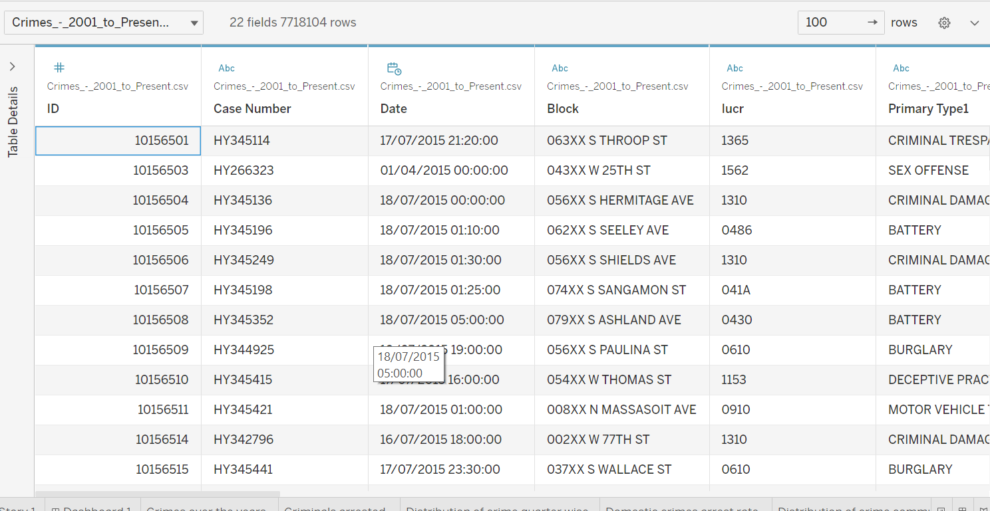
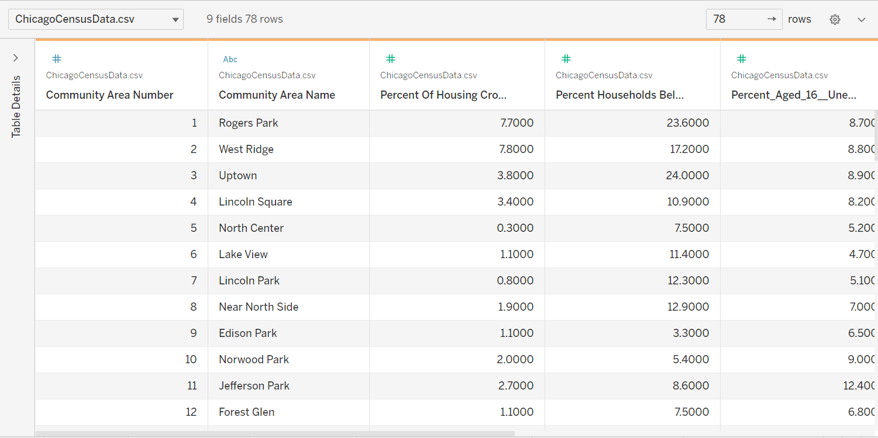
Joined datasets by community Area
Dataset
Crimes Dataset 2000 to Present – has 22 variables and 7.7 million rows
Chicago census data – 9 variables and 77 rows

Slide 6
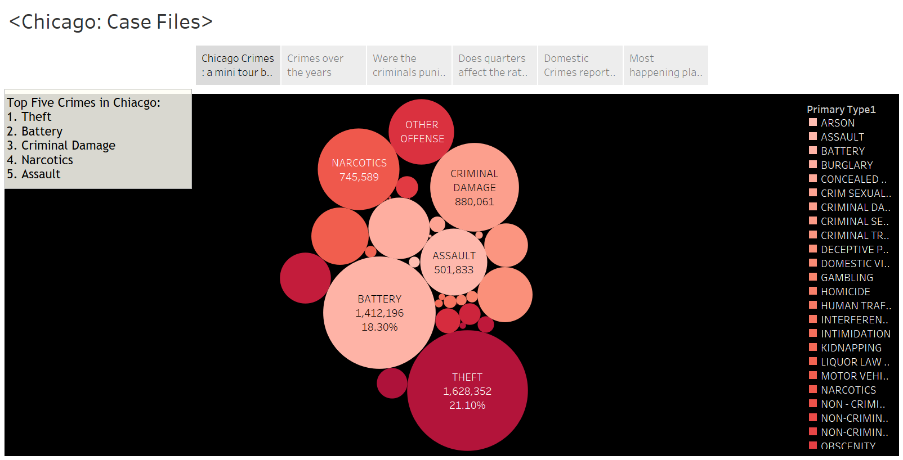
Distribution of crimes

Slide 7
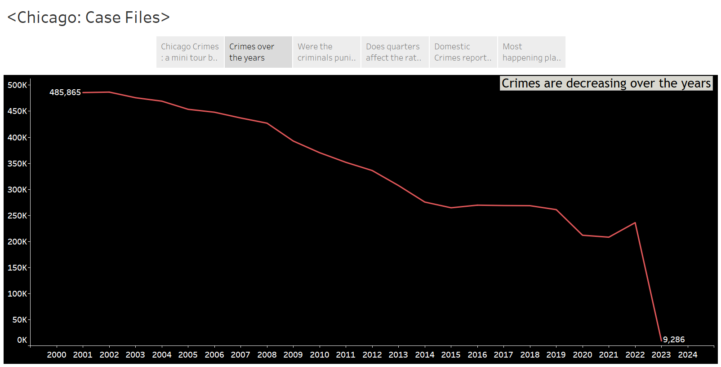
Crimes over the years

Slide 8
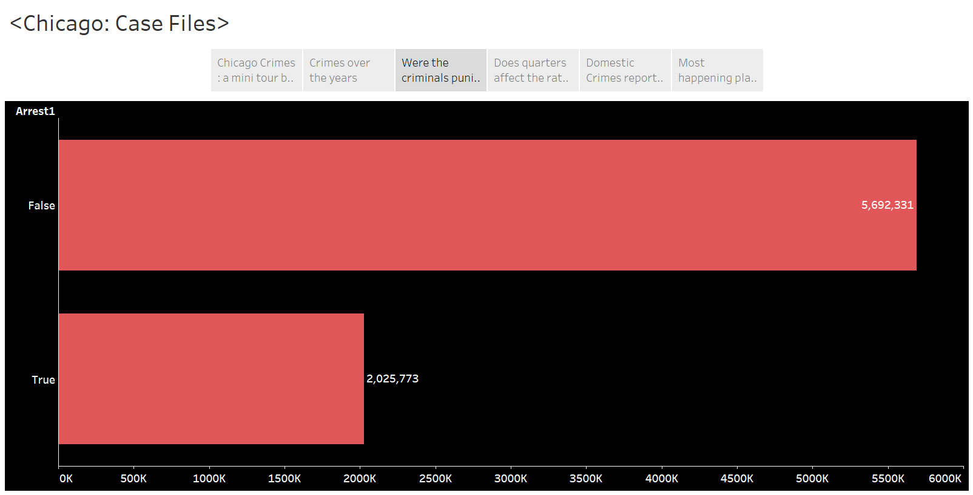
Reported incidents and arrested criminals with census data

Slide 9
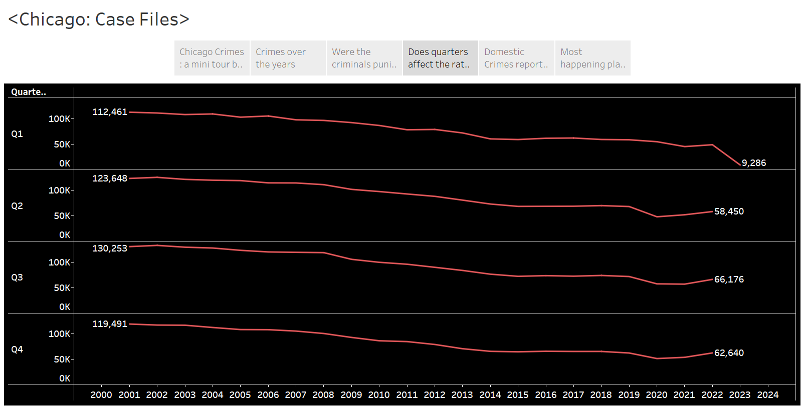
Crimes over the quarters

Slide 10
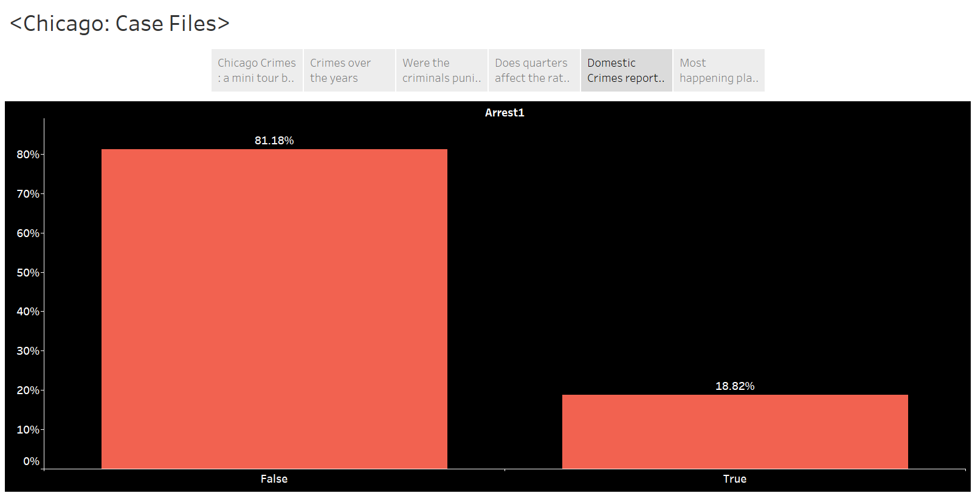
Arrest rate for domestic crimes

Slide 11
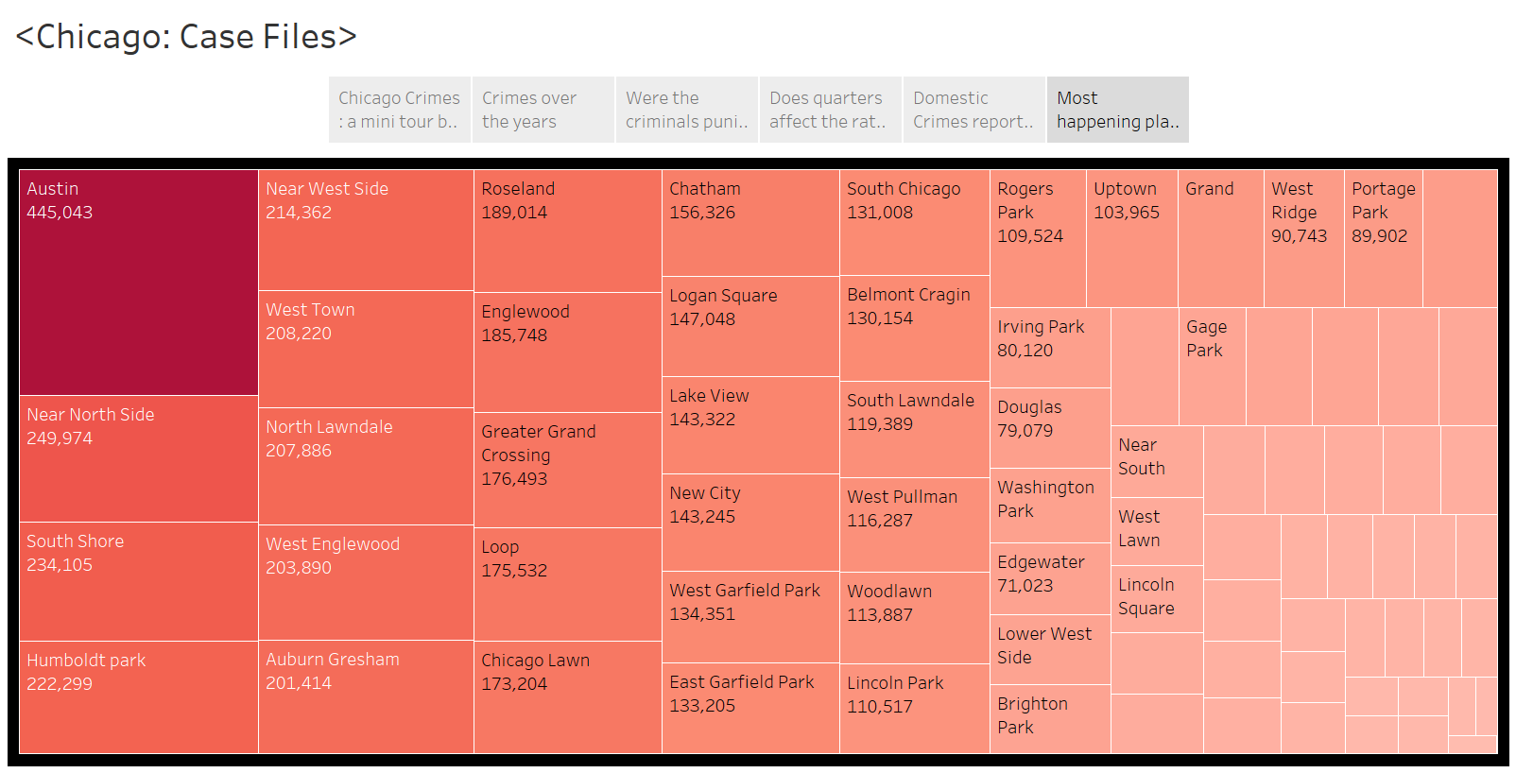
Distribution of crimes over Community area

Slide 12
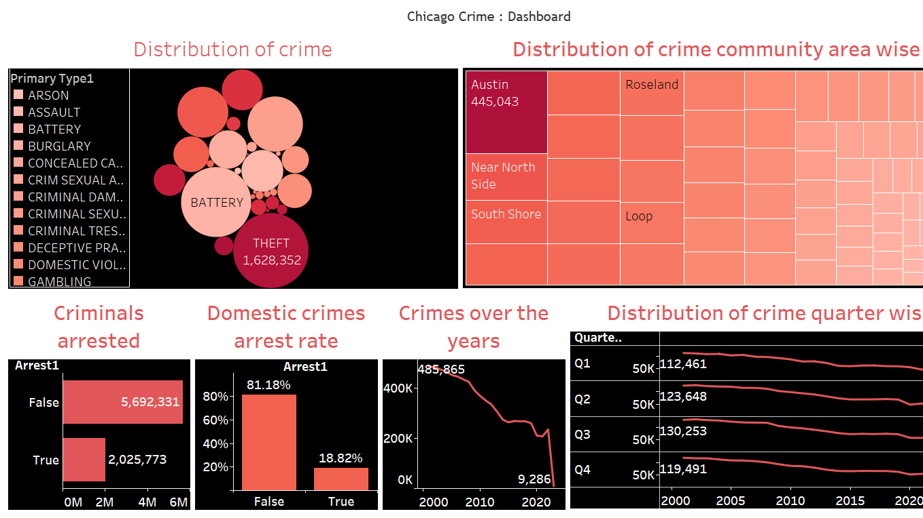

Slide 13
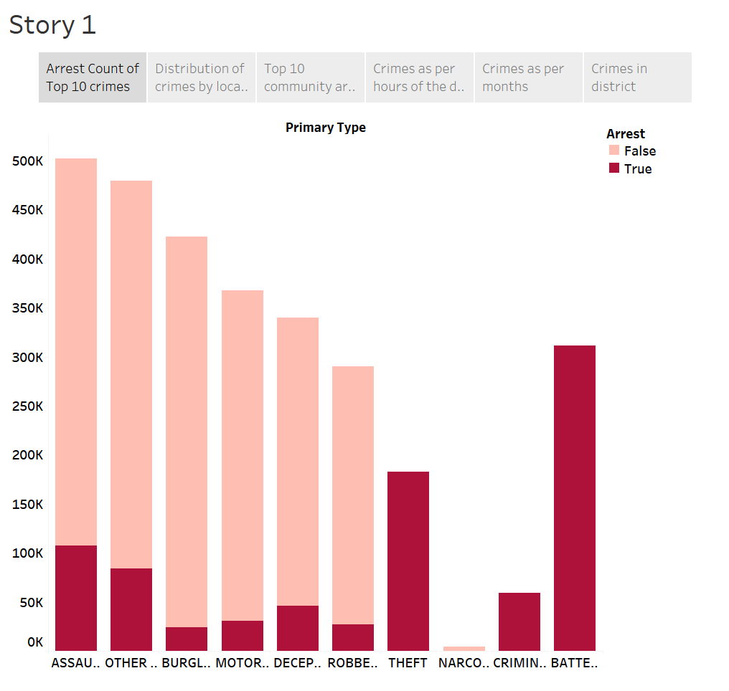
According to Community area, we can see here Top 10 crimes who have been arrested and not arrested .
Assault being Top most crime.
Narcotics being the least with no arrest percentages.
Battery is the crime where all arrests were made.
Arrest Count of Top 10 Crimes

Slide 14
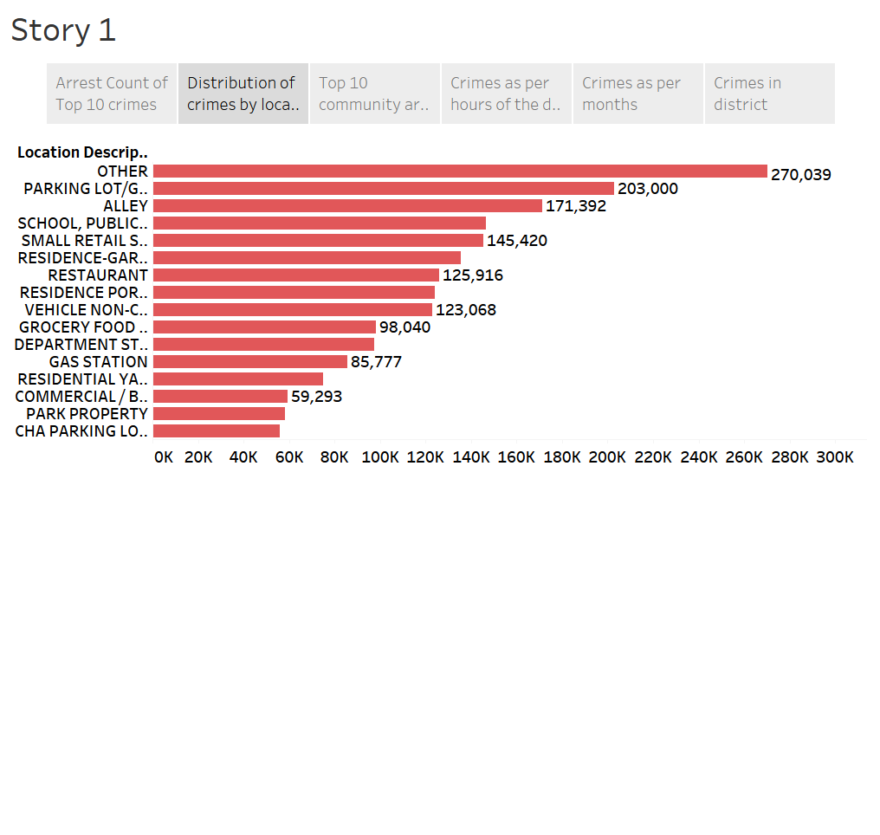
Crime can be committed anytime, anywhere or whenever your luck is not with you.
So least crimes were committed at Parking Lots of residential areas and most too at parking lots but of non residential areas.
Then comes, Commercial properties, Gas station, Restaurants and it increases till Alley.
Distribution of Crimes by Location

Slide 15
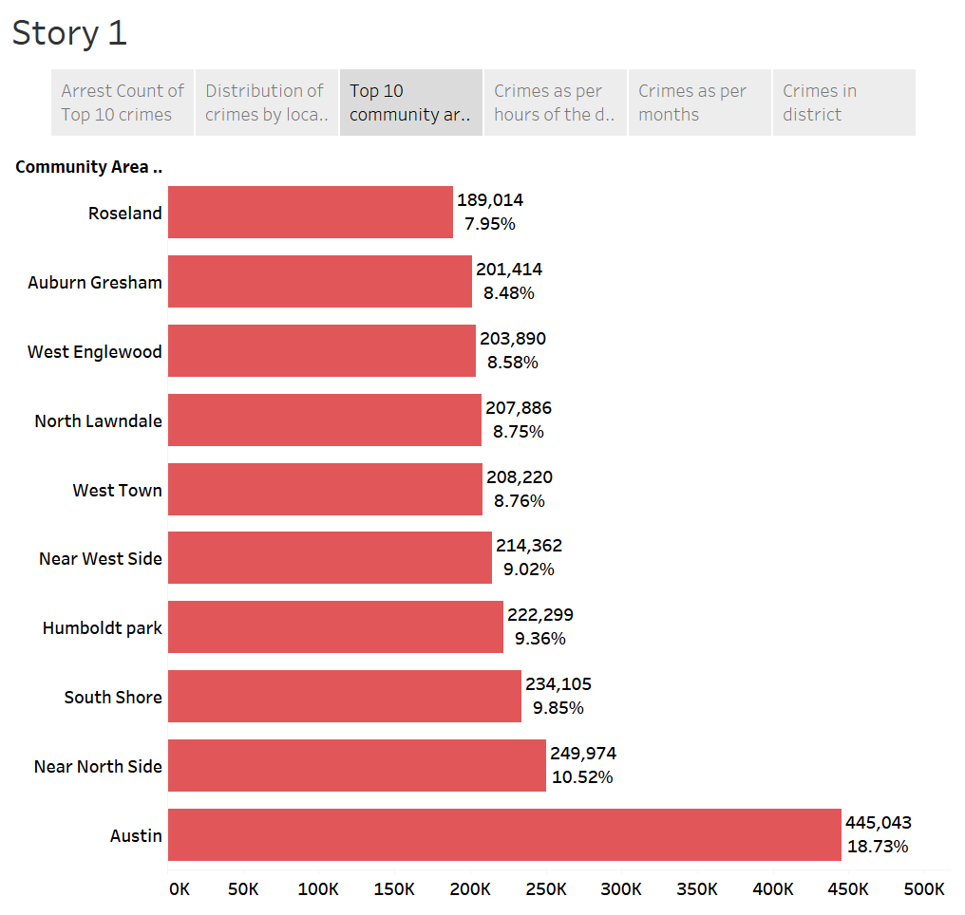
As last time we saw that Austin was the most Criminal place in Chicago. This time we can see where we can be a victim at Chicago if we plan to go on a trip or for jobs.
First place takes comes Austin with 18.73% crime rate.
10th place is for Roseland with 7.95%.
Average place is Near west side and West Town.
Top 10 Community Area with Low Crimes

Slide 16
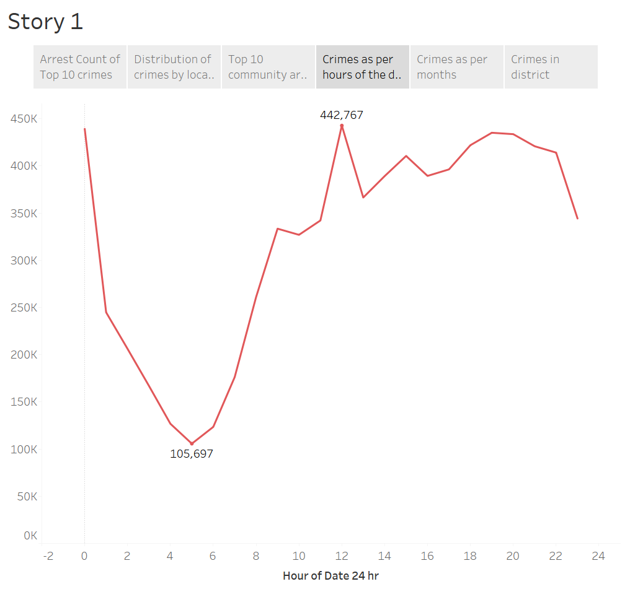
Here we will see that what hours of the day are safe and which are not at all.
Generally Crimes happen at night but here we are talking about Chicago crimes.
So most crimes are committed during lunch breaks that is between 12:00-14:00 PM.
And least between 4:00-6:00 AM.
Crimes as per hours of the Day

Slide 17
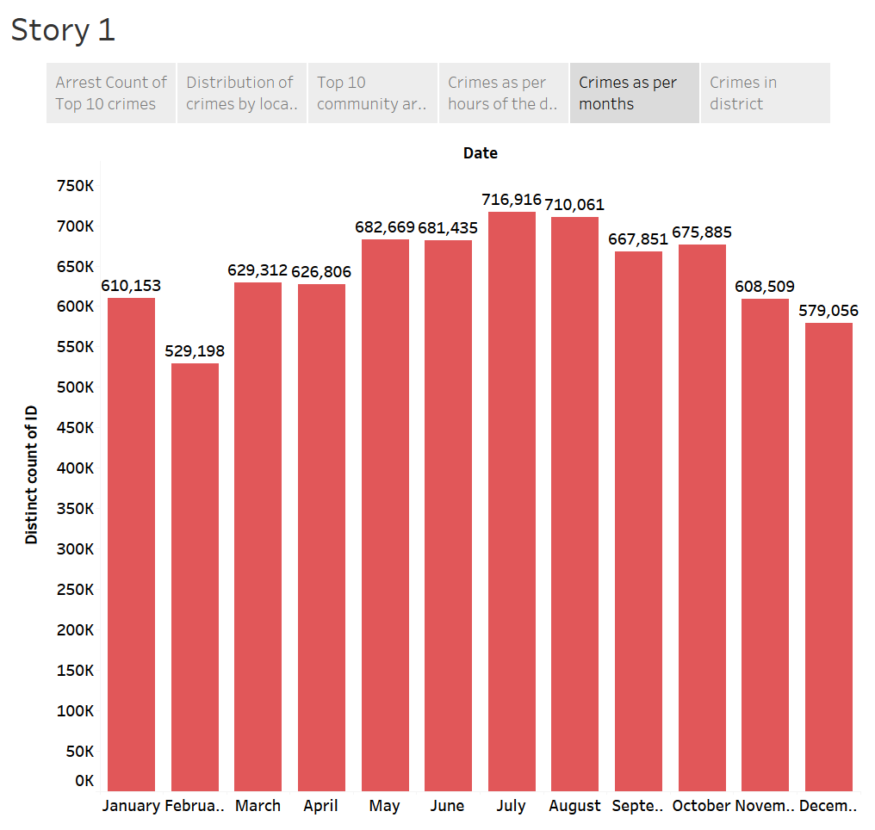
Most happening crimes happen in July, August and least during February and December.
Plan your travels or stays accordingly!
Crimes as per month

Slide 18
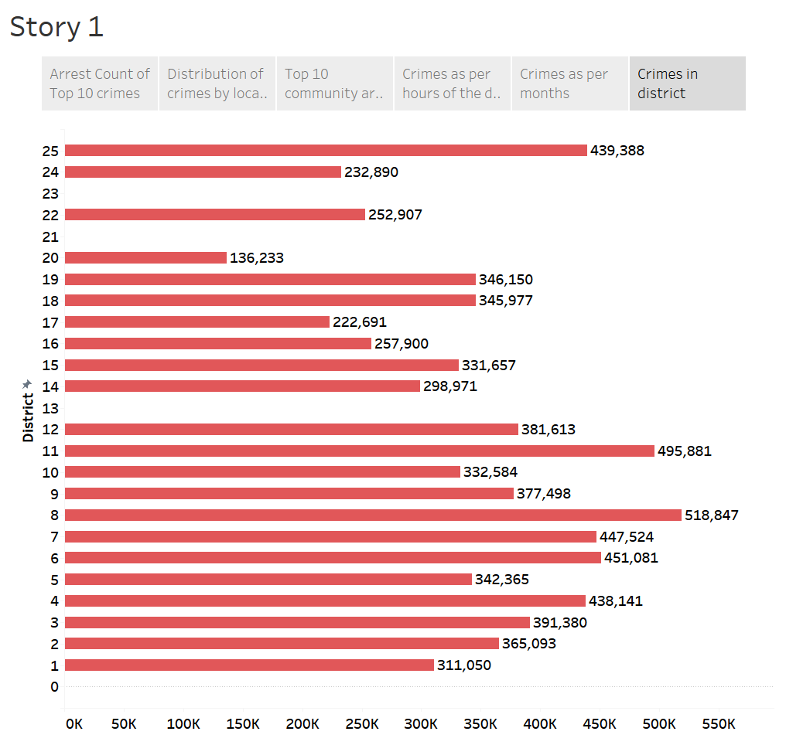
Crimes according to District numbers. So most crimes are in district number 8.
And least in 13.
Crimes in districts

Slide 19
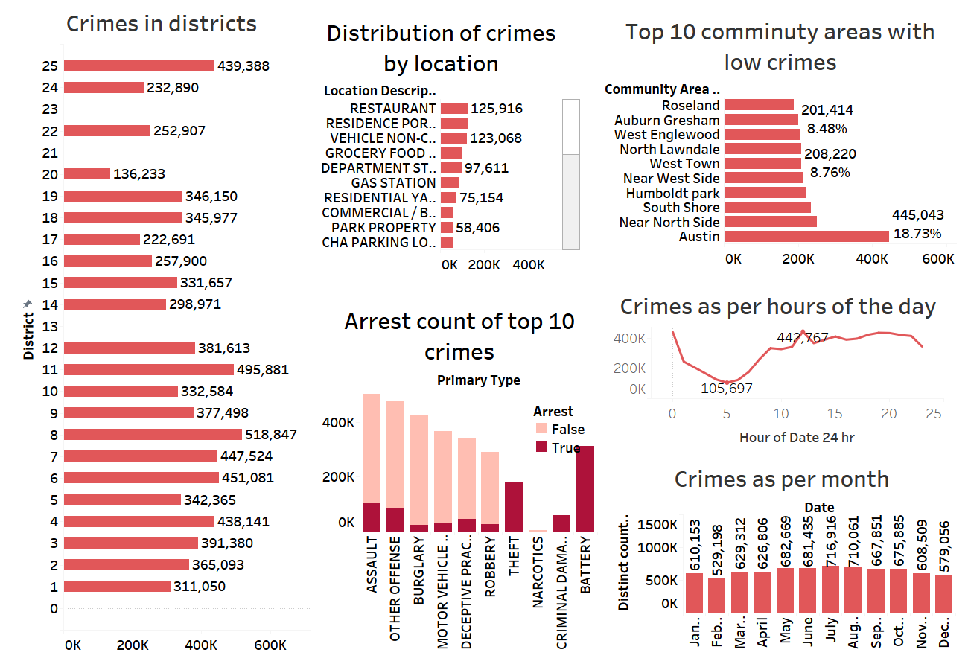

Slide 20
Summary
Crimes have been decreasing over past two decades.
Most number of crimes happened in Austin.
Most of the reported crimes were of Theft which accounted for 21.10%.
First quarter of the year showed less number of crimes than rest of the year.
Most of the criminals were not arrested in reported crimes case.

Slide 21
Thank You!

